Slide 1


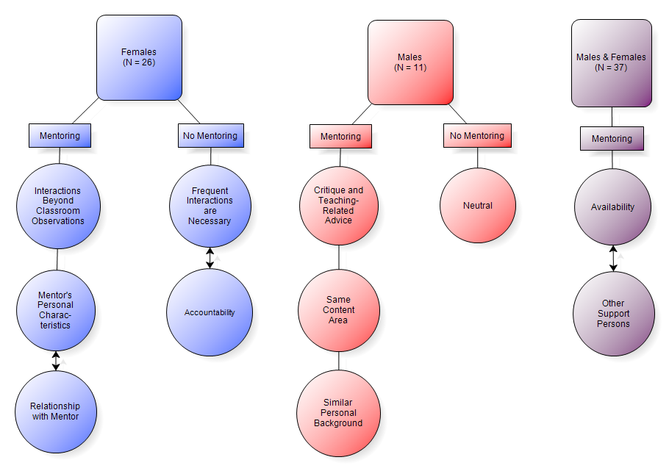

UNIVERSITY OF MINNESOTA
Examining Scholars’ Gender and Mentoring Experiences
Maureen Braam, Anica Bowe, Christina Madsen, Allison Kirchhoff
College of Education + Human Development
Department of Educational Psychology
Background Information
Recent research indicates that students in high need areas are much more likely to be taught by unqualified teachers, such as substitute teachers¹ or teachers with emergency certification². Retention of high quality teachers is particularly difficult for high need schools. Further, retention differs based on certain teacher characteristics. Attrition is higher for new teachers, and is the greatest for new female teachers³. In addition, the proportion of female college graduates going into teaching, and the proportion of entering teachers who are female, have both declined in recent years⁴.
The Noyce Scholarship Program intends to decrease this problem by recruiting highly qualified science, technology, engineering, and mathematics (STEM) majors and professionals to become K-12 mathematics and science teachers. The program provides funds to colleges and universities for scholarships, stipends, and academic programs for undergraduate STEM majors and graduate students holding STEM degrees who commit to teaching in high need K-12 school districts.
Data for this poster comes from a larger three-year evaluation conducted by the Noyce Evaluation Team at the University of Minnesota examining the broad effects of the Noyce Scholarship Program.
Research Question
This poster explores the relationship between mentoring experiences and scholar gender. It was predicted that scholar gender would be associated with different mentoring experiences, with male scholars receiving more mentoring experiences than females. It was also predicted that mentoring experiences would differ between males and females based on age. Further, it was hypothesized that male scholars would express different expectations of mentoring experiences than female scholars.
Data Collection & Analysis
Quantitative data was obtained from a Web-based scholar survey that was issued to Noyce scholar recipients in 2007. Items included questions about the scholars’ experiences in their teacher preparation/certification programs and in teaching. Of the 1504 Noyce scholar recipients, 507 participated in the survey. Comparative analyses were done to explore the relationship between gender and items pertaining to scholar mentoring experiences using one-way ANOVA and simple regression analyses. Qualitative data came from scholar interviews (N = 37) which were conducted on a volunteer basis. This study explored scholars’ responses to questions that probed for the type, amount, and perceived quality of mentoring experiences they received. These interviews were transcribed verbatim, coded, and themes were developed.
Results
Survey
Descriptive statistics exploring items measuring mentoring experiences revealed that males reported a higher level of mentoring experiences (.123, .940) compared to females (-.081, .836). This difference was significant (F_{1,462}, p = .017). To further explore this difference, males and females were separated into age quartiles and regression analyses were conducted. Results demonstrated that the combination of gender and age was important in predicting mentoring experiences (F_{1,462}, p = .034).
Interview: Different Expectations of Mentoring Experiences between Males and Females
Different Expectations of Support—Quotes from Scholars:
One mentee described herself as: “…somebody who needs a lot of guidance, and needs to feel like [I’m] welcome [at the school], and needs to feel like [my] hard work is being appreciated.” –Mindy*
“So rather than being in the official mentoring program I went for more the unofficial mentorship with people that I had established relationships with.” –Lucy*
About his mentor: “…[he] really understands…not only the content needs in the mathematics department, but he also understands the pedagogical needs and, you know, the classroom management issues, and he’s very supportive.” –Dirk*
“It’s important to find support you need, don’t expect other people to give it to you, don’t expect, even though the State says you’re supposed to have a mentor, make sure that you’re finding them on your own.” –Ben*
*Names changed to protect confidentiality.
Discussion
The survey data support the notion that males received more mentoring experiences than females. The interviews suggest that male and female scholars expected different types of support. Males emphasized the importance of having access to a person with the ability to inform, critique, and advise, especially in their content area; whereas females looked for a person who could provide information specific to their content area and K-12 level, and a person who could provide this information in the context of a strong personal relationship.
In support of these findings, several studies of gender and mentoring experiences discuss the difficulty females experience in identifying and establishing mentor relationships^{5,6}, and also suggest that women are less likely than men to have mentors⁷.
Differences in quantity and quality of mentoring experiences may have implications for teacher retention. Specifically, these findings could account for greater attrition rates in new female teachers.
Limitations
The data analyzed in this study were gathered prior to developing the research question. As a result, there was no opportunity to probe scholars for more detailed information regarding their mentoring experiences. In addition, interview respondents may differ from non-respondents, so there may be systematic differences in these respondents that is not representative of the population of Noyce scholars.
References
1. National Center for Educational Statistics (NCES)(2006). 2003–04 Schools and Staffing Survey. Retrieved June 25, 2008, from http://nces.ed.gov/pubs2006/2006313.pdf
2. Christenson, B., & Levine, R. (1998, February). Public school districts in the United States: A statistical profile: 1987–88 to 1993–94. U.S.Department of Education. National Center for Education Statistics. NCES 98–203. Washington, DC: Government Printing Office.
3. Guarino, C. M., Santibanez, L., & Daley, G. A. (2006). Teacher recruitment and retention: A review of the recent empirical literature. Review of Educational Research, 76(2), 173.
4. Broughman S.P., & Rollefson M.R. (2000). Teacher Supply in the United States: Sources of Newly Hired Teachers in Public and Private Schools. NCES 2000-309. Washington, DC: National Center for Education Statistics.
5. Kanter, R. M. (1977). Men and women of the corporation. New York: Basic.
6. Nieva, V. F., & Gutek, B. A. (1981). Women and work: A psychological perspective. New York: Praeger.
7. Noe, R. A. (1988). Women and mentoring: A review and research agenda. Academy of Management Review, 13, 65-78.
Acknowledgements
Part of this project was funded by the National Science Foundation (Grant # REC0514884).
School Psychology
250 Education Sciences Building
56 E. River Road, Minneapolis, MN 55455
Contact: Maureen Braam: braa0080@umn.edu

